Slide 1


Slide 2


Slide 3


Slide 4


Slide 5


Slide 6


Slide 7


Slide 8


Slide 9


Slide 10


Slide 11


Slide 13
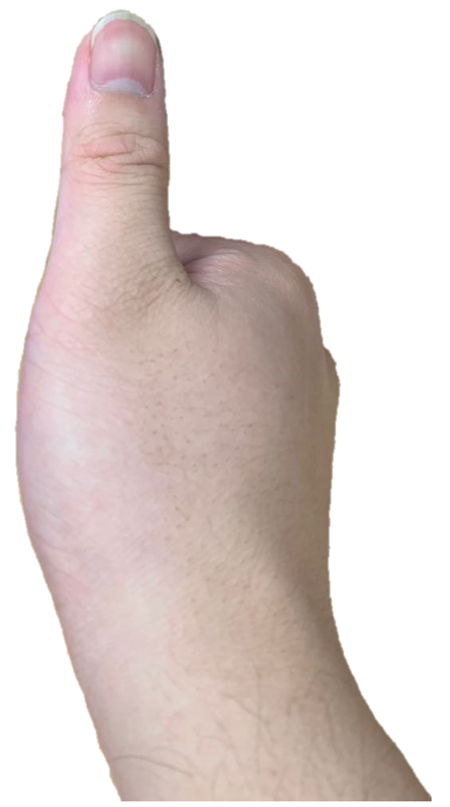

Slide 14
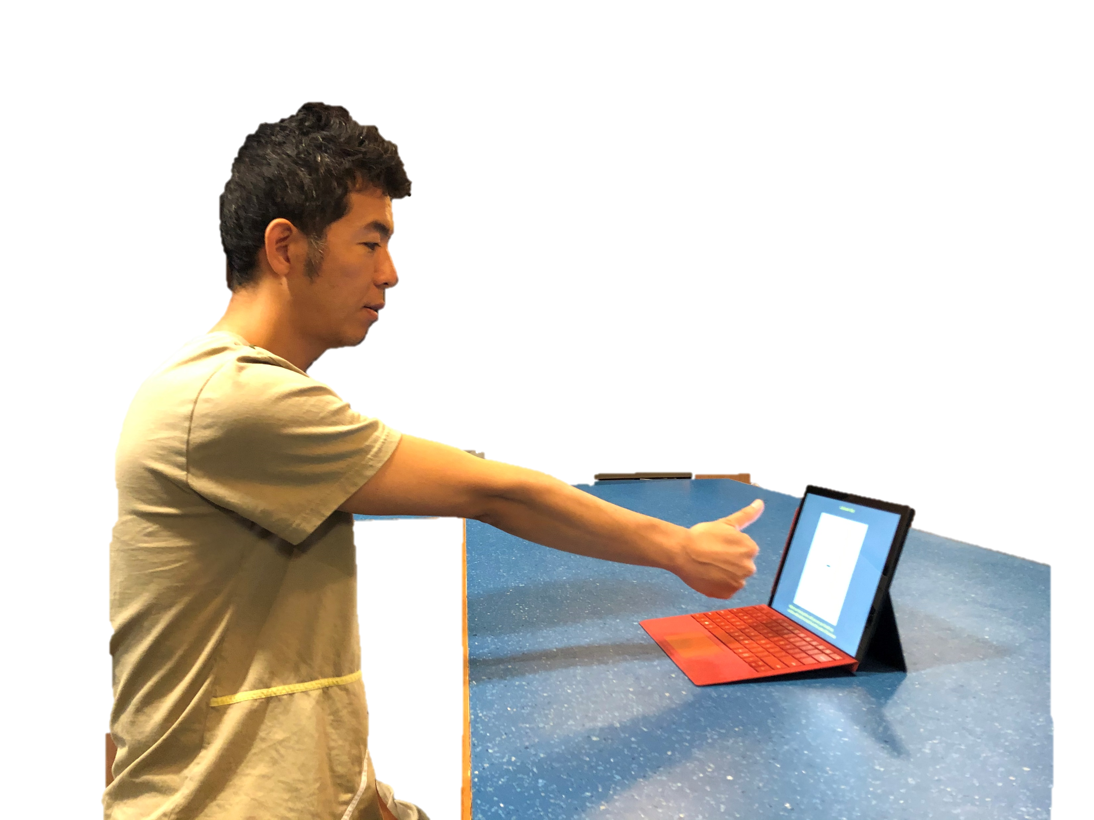
Keep your arm straight

Slide 15
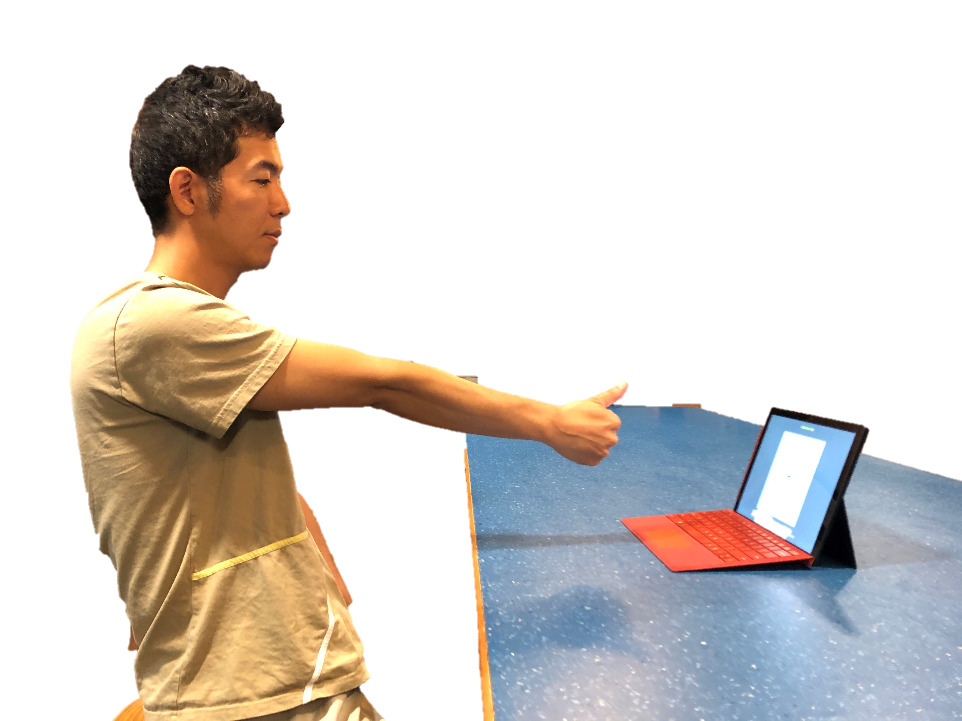
Adjust the distance between your body and the screen

Slide 16
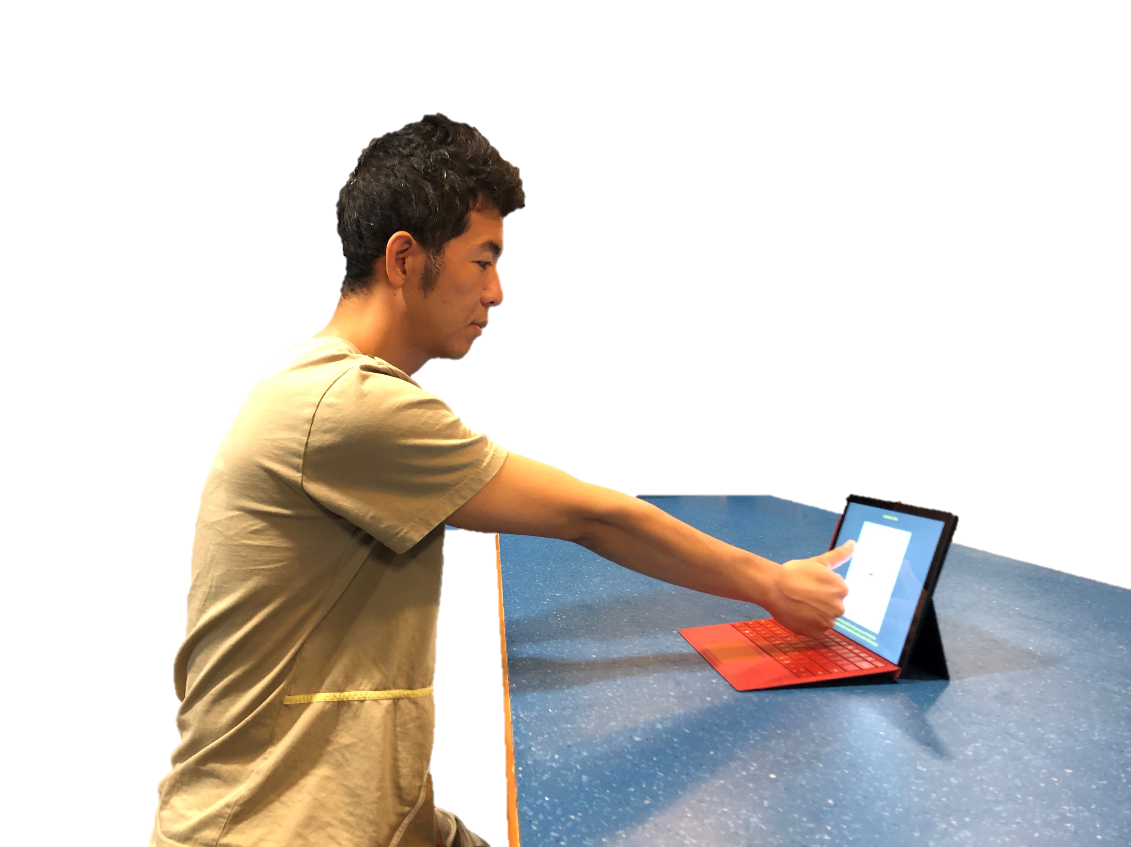
Adjust the distance between your body and the screen

Slide 17
